Slide 1
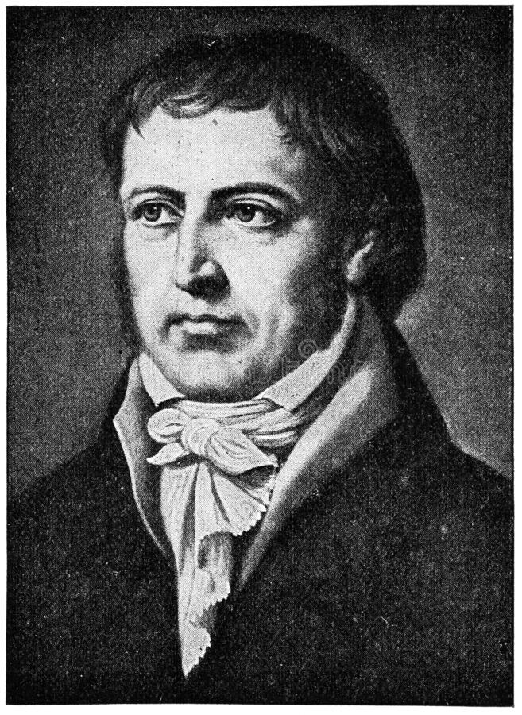
Georg
Wilhelm Friedrich Hegel
Person in History
By
Akib Hasan
19203014

Slide 2
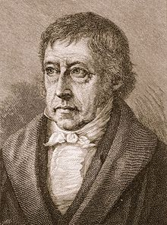
Historical Background
Germany
Education (Theology & Philosophy )
Occupation
1770-1831

Slide 3
Absolute Idealism
“The rational alone is real.”

Slide 4
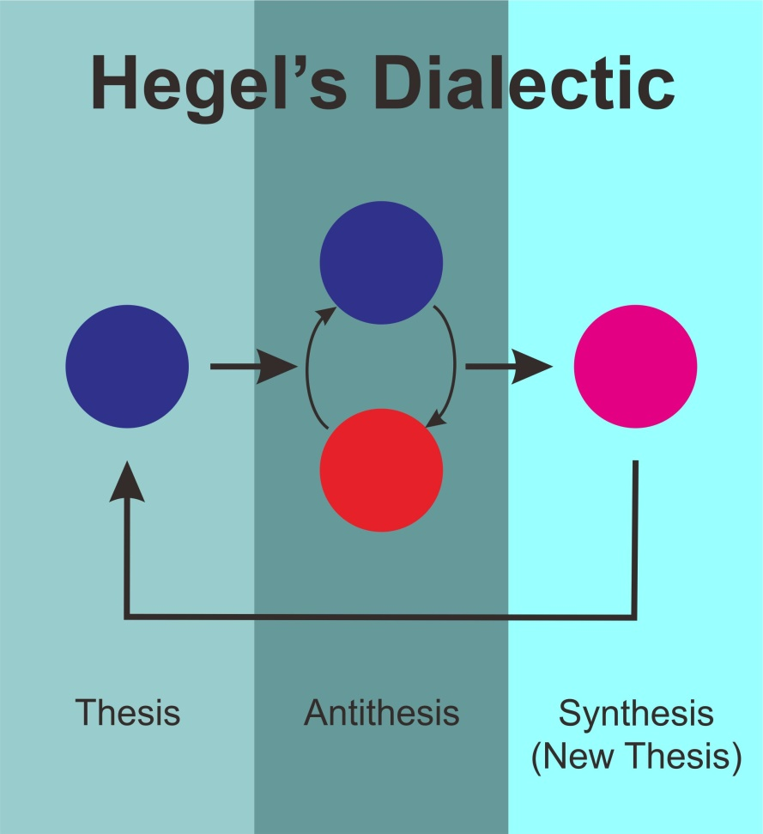
Dialectical Argument

Slide 5
Thank You

